Slide 1

Kevin Sousa
Phone: 817-556-1412
Email: kevinnsousa97@gmail.com
Result-oriented and detail-oriented professional with a Bachelor's degree in accounting and expertise in data analysis using SQL, Excel, Tableau, Python, and Power BI. Highly skilled in extracting actionable insights from complex datasets, identifying trends, and presenting findings to support data-informed decision-making.

Slide 2
Projects
1. Medical Staffing Agency
Analysis with the goal of determining when to send staff, and how many, to each state in preparation for the upcoming Flu Season.
2. GameCo.
descriptive analysis of a video game data set to foster a better understanding of how GameCo’s new games might fare in the market.
3. Rockbuster Stealth LLC
Analysis to help with the launch strategy for the new online video service.
4. Instacart
Business Intelligence Analysis to ensure Instacart targets the right customer profiles with the appropriate products.
Achievement 6
In progress.

Slide 3
1. Medical Staffing Agency

Slide 4
Medical Staffing Agency
Tools Implemented
Excel
Data
CDC Data
Objectives
Provide information to support a staffing plan, detailing what data can help inform the timing and spatial distribution of medical personnel throughout the United States.
Tableau
US Census Data
This analysis will also determine whether people over the age of 65 are at higher risk of complications from Influenza.

Slide 5
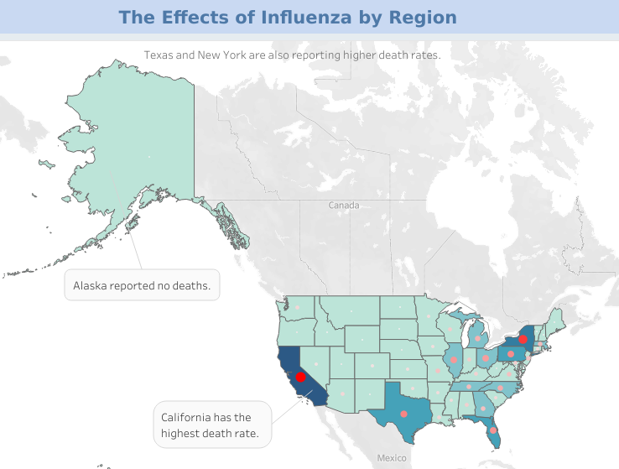
Which States Are Impacted The Most?
This chart showcases the amount of deaths per state.
The darker red dots represent a larger death rate, while the lighter dots represent a lower death rate.
States with larger population densities tend to have higher death rates. This is represented by the darker shades of blue.
This visualization clearly demonstrates that California has the highest death rate in the country.

Slide 6
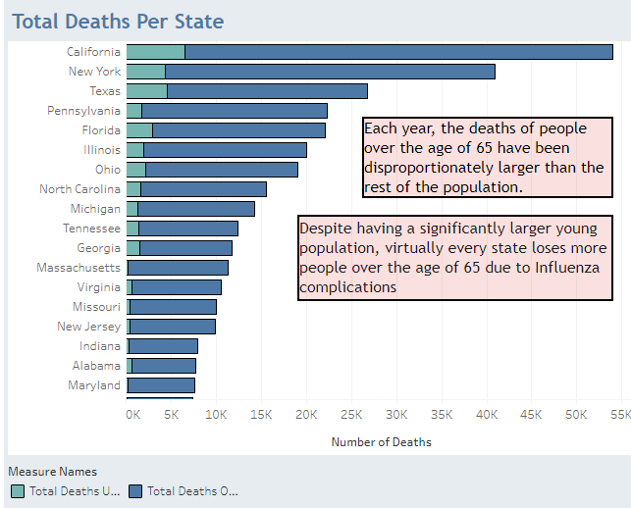
Which Demographic Is Impacted The Most?
This chart showcases the amount of deaths split up by two age groups:
Light blue under 65
And Dark blue, over 65.
The final analysis indicated that approximately 91% of all deaths are from people aged 65 or higher.

Slide 7
Summary And Expert Suggestions
It is evident that higher populated areas and regions with a higher number senior residents are more likely to suffer from Influenza related deaths. Medical facilities in California, New York, and Texas should receive priority when allocating medical personnel because they have by far the highest death rates.
States with higher senior citizen residents and deaths should be focused on when it comes to vaccine campaigns and should receive more funding to fight Influenza.
By prioritizing medical personnel allocation to states with higher death rates, focusing vaccine campaigns on regions with higher senior citizen populations, and providing additional funding to combat Influenza in states with higher mortality rates, public health authorities can better address the challenges posed by Influenza outbreaks. These measures can help save lives, protect vulnerable populations, and reduce the burden of Influenza-related illnesses on healthcare systems.
You can access the Tableau visualizations here.

Slide 8
2. GameCo

Slide 9
GameCo
Tools Implemented
Excel
Data
The data was obtained from vgchartz.
Objectives
Perform a descriptive analysis of a video game data set to foster a better understanding of how GameCo’s new games might fare in the market
PowerPoint

Slide 10
Analysis of Yearly Sales and Regions
Sales have been on a downward trend since 2008. There is not enough data to give clear insight as to what is causing this downtrend.
The North American market, which was historically the highest seller, has begun to decline over the last few years, beginning in 2002. It was surpassed by the European market in 2016 which has seen steady growth.

Slide 11
Analysis of Sales by Genre & Publishers
North America holds the largest share of the global market in virtually every genre, losing only to Japan in roleplaying.
There are a handful of publishers that lead sales world wide. The top 3 are Nintendo, Electronic Arts, & Activision.

Slide 12
Summary And Expert Suggestions
As seen in the data, the North American market has been trending downwards for some time (since 2002) our analyst team will need the data that will help us determine whether this is a GameCo specific issue, or if the market as a whole is trending downwards.
I suggest that GameCo take further steps into understanding what is causing the sharp decline in sales beginning in 2008. The analyst team needs to know if this decline in sales stems from an internal issue or if it can be attributed to outside influences outside of GameCo, such as digital sales.
By conducting a comprehensive analysis to determine whether the declining trend is specific to GameCo or indicative of industry-wide changes, investigating the reasons behind the sharp decline in sales since 2008, and evaluating the impact of digital sales, GameCo can gain valuable insights and make informed decisions. This will enable them to address internal issues, adapt to industry dynamics, and develop strategies to reverse the declining trend and regain market competitiveness.

Slide 13
3. Rockbuster Stealth LLC

Slide 14
Rockbuster Stealth LLC
Tools Implemented
SQL
Data
The data was obtained from vgchartz.
Objectives
Tableau
The Rockbuster Stealth management team is planning to use its existing movie licenses to launch an online video rental service in order to stay competitive.
You can view the Tableau visualizations here.
You can view my video presentation here.

Slide 15
Rockbuster Company Overview
Number of Staff
2
Average Rental Rate Per Category | ( In days)
rating | avg
PG | 3.05
R | 2.94
NC-17 | 2.97
PG-13 | 3.03
G | 2.89
Total Revenue
$61,312.04
Average Rental Cost
$2.98
Total Inventory
16,044
Average Rental Duration
5 days
Total Customers
599

Slide 16
Which movies contributed the most/least to revenue gain?
Most Popular Genres | Revenue Generated
Sports | $4892.19
Sci-Fi | $4336.01
Animation | $4245.31
Least Popular Genres | Revenue Generated
Thriller | $47.89
Music | $3071.52
Travel | $3227.36
Sports movies have been the most profitable worldwide, bringing in $4,892.19 of revenue.
The Thriller genre has been suffering and is trailing by far, bringing in only $47.89 of revenue in 2020.

Slide 17
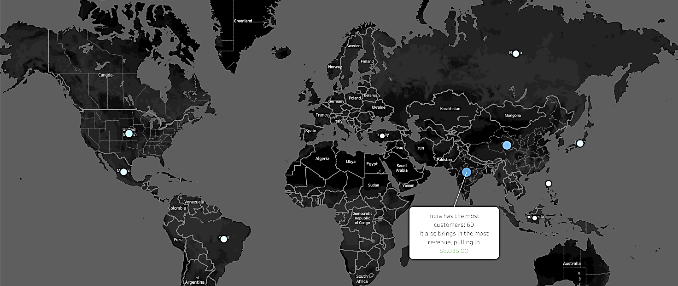
Top 10 Countries
Country | Customers
India | 60
China | 53
United States | 36
Japan | 31
Mexico | 30
Brazil | 28
Russian Federation | 28
Philippines | 20
Turkey | 15
Indonesia | 14

Slide 18
Summary And Expert Suggestions
Rockbuster should focus on the countries with the most clients as they also generate the most revenue.
Management needs to find out why the disparity between Thriller movies and other genres is so large.
To effectively compete with large streaming platforms such as Netflix or Amazon, Rockbuster must make its film selections available online to customer for a monthly subscription fee.
By focusing on high-revenue countries, addressing the disparity in Thriller movies, and embracing online availability through a subscription model, Rockbuster can position itself as a strong competitor in the streaming industry and capitalize on its customer base to drive growth and revenue.

Slide 19
4. Instacart

Slide 20
Instacart
Tools Implemented
Python
Data
The data was obtained from open-source data sets from Instacart.
Objectives
To perform an initial data and exploratory analysis of some of Instacart’s data in order to derive insights and suggest strategies for better segmentation based on the provided criteria.
GitHub Portfolio.

Slide 21
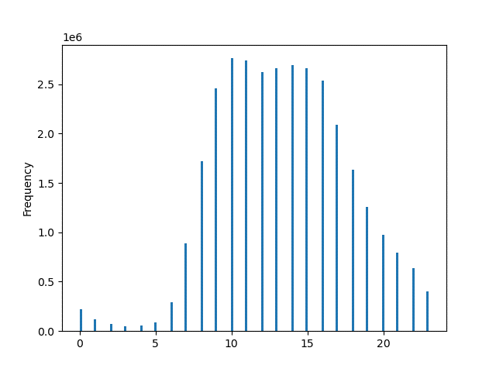
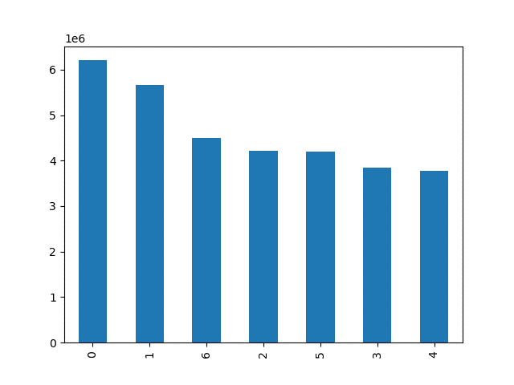
Time Analysis
The busiest hours span from hours 10 -17.
Saturday is the busiest day, while Wednesday is the least busy.

Slide 22
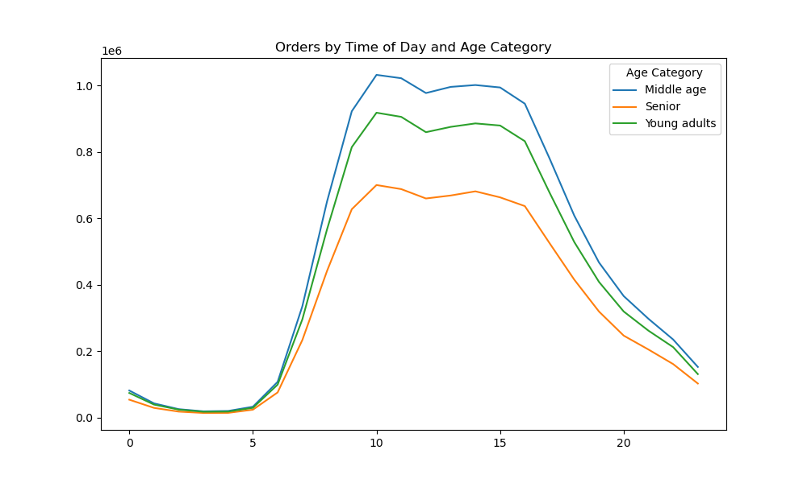
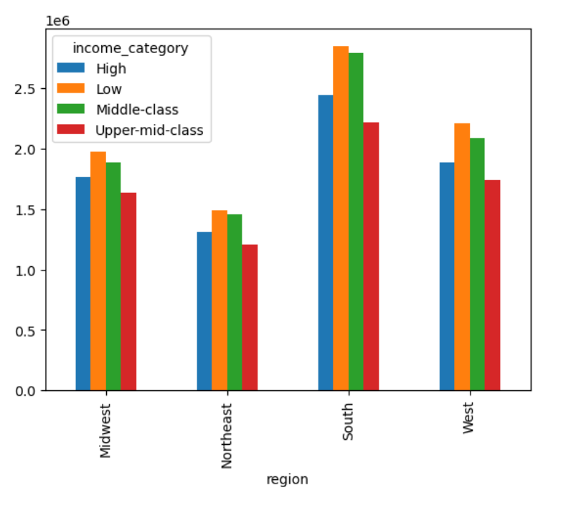
Customer Profile Analysis
Middle aged customers are making the most purchases.
The southern region contains the highest purchase activity than any other region.

Slide 23
Summary And Expert Suggestions
Continue emphasizing the competitive advantage of Instacart's impressive sales and affordable prices, as they have played a significant role in making it a popular choice among customers. This should be highlighted in marketing campaigns and customer communications.
Recognize that the customer base primarily consists of individuals with middle and low-income status. This indicates that the pricing strategy is resonating well with both groups. To maintain their loyalty, ensure that prices remain reasonable and competitive.
Acknowledge the dominance of the southern region in terms of order volume compared to the northeast. This suggests that delivery services are a significant factor in customer preference. Consider investing in expanding and optimizing delivery services in this region to further enhance customer convenience.
Recognize that the middle-aged customers, who are typically married with mid-size families, form a significant customer segment. The highest sales in the produce and dairy department indicate their needs. Offer attractive deals and promotions specifically targeting family necessities like produce and dairy to cater to this demographic.

Slide 24
5. Coming Soon

